Slide 1
CLASS VIII
RATIONAL NUMBERS
CHAPTER NUMBER ONE
MADE BY:S N MISHRA

Slide 2
Various types of numbers
Natural Numbers : All counting numbers are known as natural numbers. Eg: 1,2,3,…, ∞.
Whole numbers: All counting numbers including zero are known as natural numbers. Eg: 0,1,2,3,…, ∞.
Integers: All counting numbers with positive and negative sign including zero are known as Integers. Or All negative and positive numbers including zero are called Integers
Eg: -2,-1,0,1,2,..., ∞
There are certain numbers which does not come under these category like 1.5,1/2,…, ∞
Can you guess the type of numbers. These type of numbers are known as Rational Numbers.

Slide 3
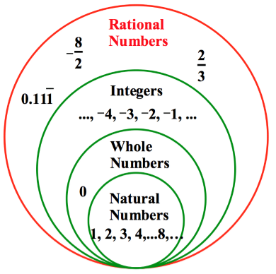
Numbers System

Slide 4
RATIONAL NUMBERS
A number is called Rational if it can be expressed in the form p/q where p and q are integers (q > 0). It includes all natural, whole number and integers.
Example: 1/2, 4/3, 5/7,1 etc.

Slide 5
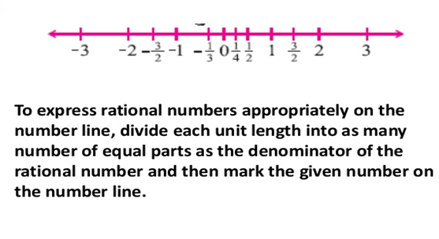
Representation of rational numbers on the number line

Slide 6
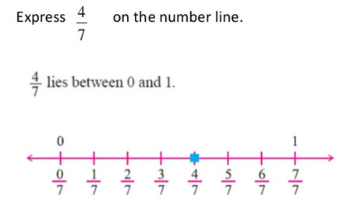
Representation of rational numbers on the number line
Question:

Slide 7
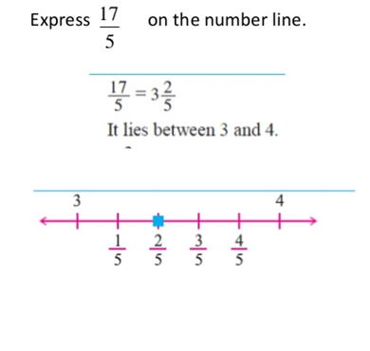
Question

Slide 8

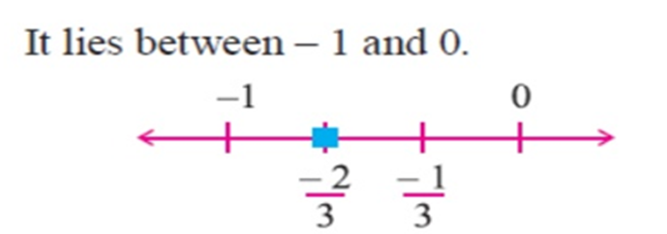
Question

Slide 9
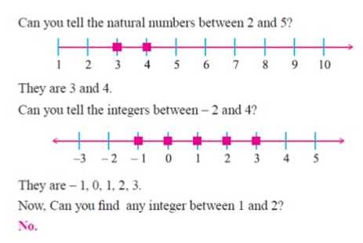

Slide 10
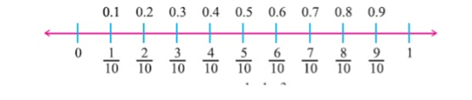
Between any two integers, we have many rational numbers. For example between 0 and 1, we can find rational numbers ,1/10,1/20,3/10,…. Which can be written as 0.1, 0.2, 0.3, ...

Slide 11
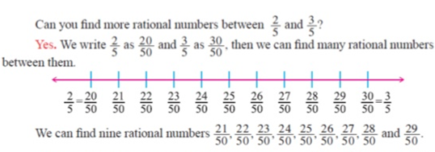

Slide 12
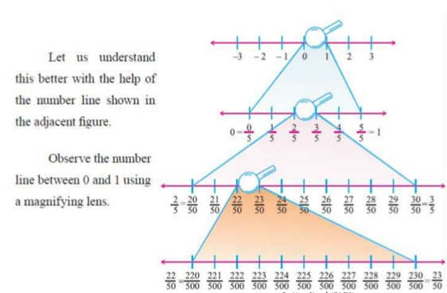

Slide 13
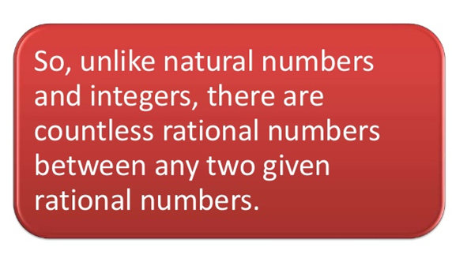

Slide 14
Properties of Rational Numbers
1.Closure Property
2.Commutative Property
3.Associative Property
4.Additive Identity
5.Additive Inverse

Slide 15
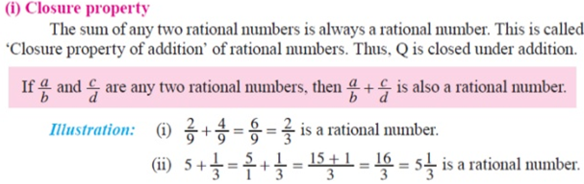
Operation Addition

Slide 16
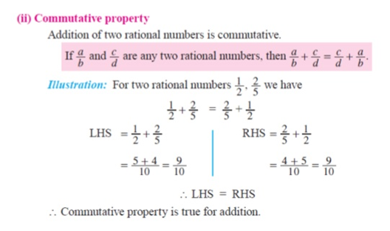

Slide 17
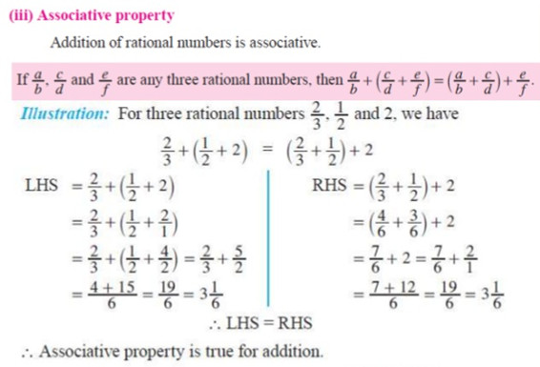

Slide 18


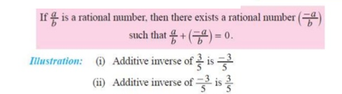

Slide 19
THANK YOU

